Slide 1
BITS Pilani
Prof.Aruna Malapati
Asst Professor
Department of CSIS

Slide 2
Logical Representation Sentence meaning

Slide 3
Today’s Agenda
Meaning representation

Slide 4
Semantics of a linguistic constituent
Word Vectors -> meaning representation
This representation allows us to solve reasoning problems
  Words are similar to each other
  Analogical reasoning
Notes:
What constitutes a meaning representation for a sentence in a language?

Slide 5
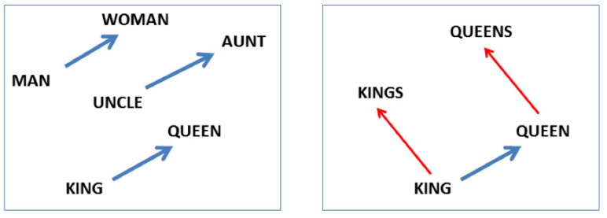
Analogy
vector(‘king’) - vector(‘man’) + vector(‘woman’) ≈ vector(‘queen’)
vector(‘Paris’) - vector(‘France’) + vector(‘Italy’) ≈ vector(‘Rome’)

Slide 6
Computational semantics
Word embeddings do not support logical Inference like:
All birds have two wings
Parrots are a kind of bird
=>
All Parrots have two wings
We need a representation meaning that link linguistics structures (words and sentences) to a representation of the state of the world, and perform inferences.

Slide 7
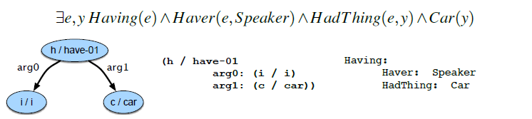
Meaning representations
Sematic Parsing is the process of assigning meaning representations to linguistic inputs.

Slide 8
Meaning Representation (Contd..)
A meaning representation consists of structures composed from a set of symbols, or representational vocabulary, which correspond to
1. Objects (speaker, car)
  2. Properties of objects (red(car))
  3. Relation among objects (owns(speaker, car) )
These describe some state of the world, which we are trying to represent and reason about.

Slide 10
Computational Desiderata for Representations
Verifiability
Unambiguous Representations
Canonical Forms
Make Inferences
Match variables

Slide 11
Model-Theoretic Semantics
Model bridges the gap between formal representation and the world.
A model represent state of affairs in the world.
Elements of the model are objects, properties of objects, and relations among objects.
Notes:
The domain of a model is the set of objects that are being represented. Each distinct thing (person, restaurant, cuisine) corresponds to a unique element in the domain Properties of objects (like whether a restaurant is expensive) in a model correspond to sets of objects. Relations between object (like whether a restaurant serves a cuisine) are are sets of tuples.

Slide 12
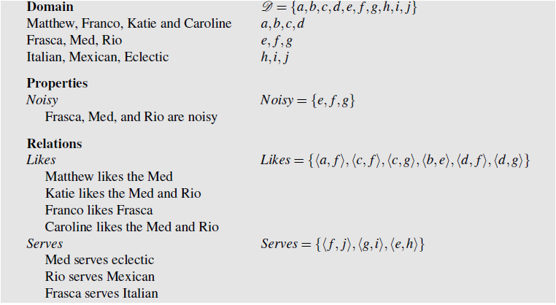
A model of the restaurant world

Slide 13
Denotation and Interpretation
A meaning representation has open-ended vocabulary of names for the objects, properties, and relations that make up the world we’re trying to represent.
Each element of the vocabulary must have a denotation in the model, meaning that every element corresponds to a fixed, well-defined part of the model.
The function that maps from the vocabulary to the proper denotations in the model is an interpretation.

Slide 14
Handling complex sentences
Katie likes the Rio and Matthew likes the Med.
Franco likes noisy, expensive restaurants.
We need an additional set of logical operators like and, or, not, and quantifiers, and corresponding truth tables.

Slide 15
First-Order Logic
First-Order Logic provides all the properties we are looking for in a meaning representation.
It provides strong basis for verifiability and inference.
Terms in FOL
  Constants
  Functions
  Variables
Relations
Logical Connectives

Slide 16
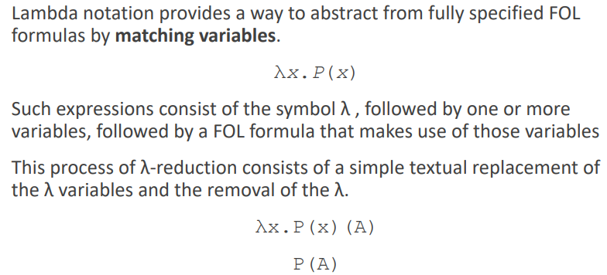
Lambda Notation

Slide 17
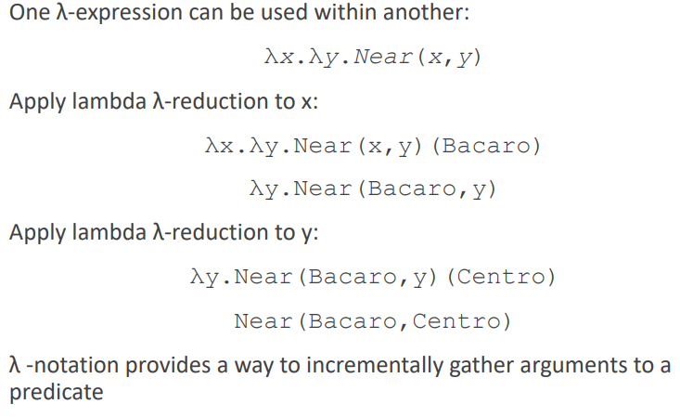
Lambda Notation (Contd..)

Slide 18
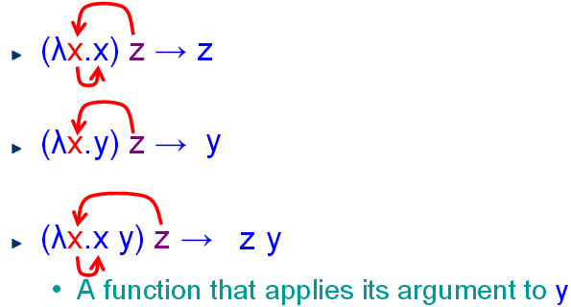
Beta Reduction Example

Slide 19
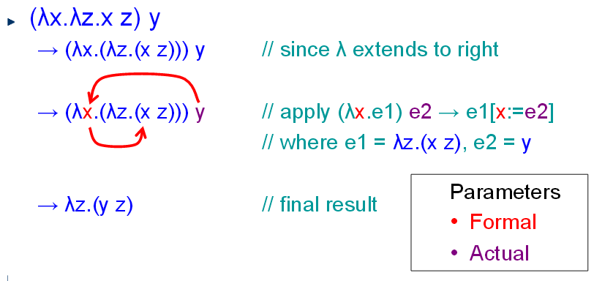
Beta Reduction Example

Slide 20

Example
// β-reduction = body[sym/replacement]

Slide 21

Example

Slide 22

Example

Slide 23
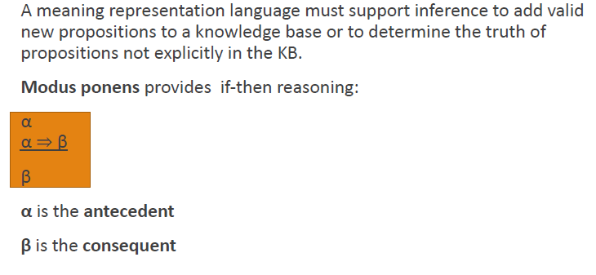
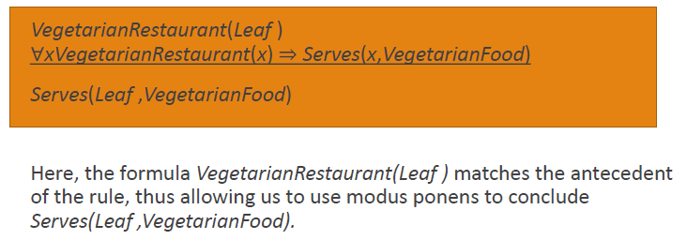
Inference

Slide 24
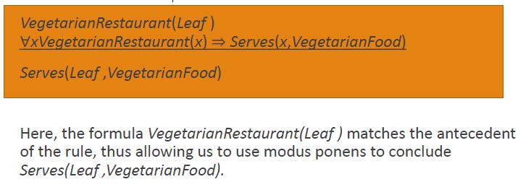
Inference

Slide 25
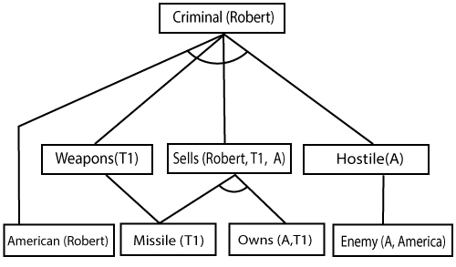
Forward Chaining
American(P) ^ Weapon(Q) ^ Hostile(R) ^ Sells(P,Q,R) → Owns(A,T1)
Missile(T1)
Missiles(P) ^ Own(A,P) → Sells(Robert,P,A)
Missile(P) → Weapons(P)
Enemy(P,America) → Hostile(P)
Enemy(A,America)
American(Robert)
Prove criminal(Robert)

Slide 26
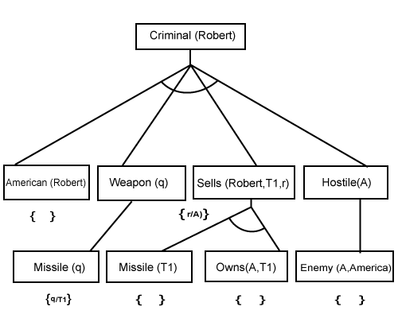
Backward Chaining
American(P) ^ Weapon(Q) ^ Hostile(R) ^ Sells(P,Q,R) → Criminals(P)
Owns(A,T1)
Missile(T1)
Missiles(P) ^ Own(A,P) → Sells(Robert,P,A)
Missile(P) → Weapons(P)
Enemy(P,America) → Hostile(P)
Enemy(A,America)
American(Robert)
Prove criminal(Robert)

Slide 27
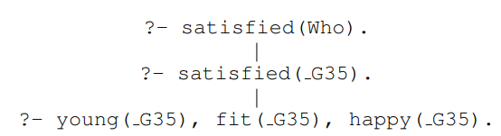
Backward Chaining
Given the Knowledge base
young(alice).
young(bob).
fit(alice).
fit(bob).
happy(bob).
satisfied(X) :- young(X), fit(X), happy(X).
?- satisfied(Who).

Slide 28
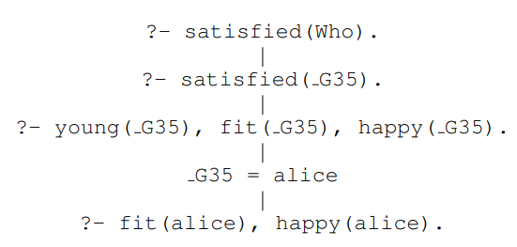
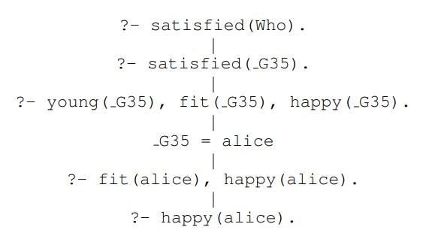
Backward Chaining (Contd…)

Slide 29
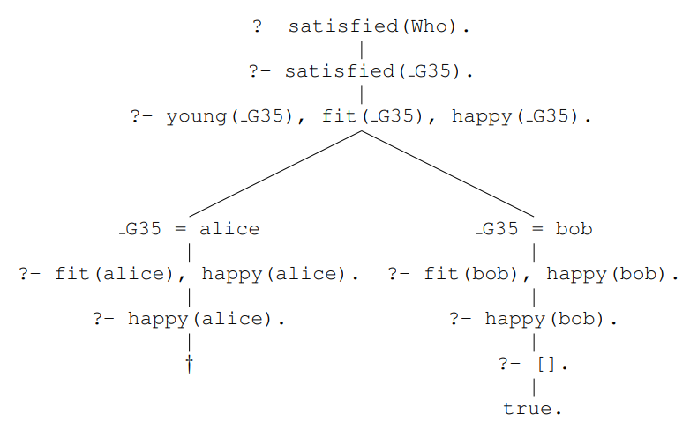
Backward Chaining (Contd…)

Slide 30
Lambda Calculus
A λ-calculus has 4 kinds of expressions (terms)
<expr>:=<constant>
| <variable>
| (<expr><expr>)
| (λ<variable>.<expr>)

Slide 31
From FOL to Lambda calculus
Augment CFG trees with lambda expressions
Syntactic composition = function application
Semantic attachments:
𝐴 → 𝛼1 … 𝛼𝑛 {𝑓 (𝛼𝑗 . 𝑠𝑒𝑚, … , 𝛼𝑘. 𝑠𝑒𝑚) }
syntactic composition semantic attachment

Slide 32
Proper Nouns
Proper nouns are FOL constants
𝑃𝑁 → NLP {NLP}
To represent the same in Lamda we use a dummy predicate x
𝑃𝑁 → NLP {𝜆𝑥. 𝑥(NLP)}

Slide 33
Common Nouns
Common nouns are predicates inside a lambda expression of type <𝑒,𝑡>
• Takes an entity, tells you whether the entity is a member of that class
𝑁 → 𝑠𝑡𝑢𝑑𝑒𝑛𝑡 {𝜆𝑥. 𝑆𝑡𝑢𝑑𝑒𝑛𝑡(𝑥)}

Slide 34
Verbs
Intransitive
  The dog ran
  She sings
  John stands
Transitive
  John loves Mary

Slide 35
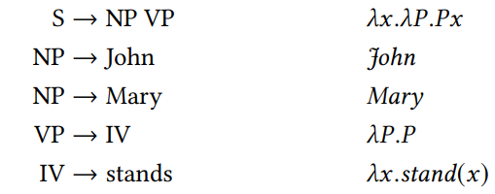
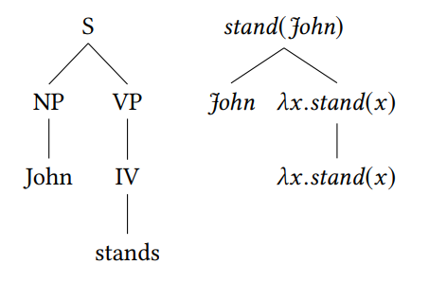
From sentence to meaning for Intransitive verbs– Example1

Slide 36
From sentence to meaning for transitive verbs - Example2
S → NP VP (VP.sem)(NP.sem)
NP → John John
NP → Mary Mary
VP → IV 𝜆𝑃 .𝑃
VP → TV NP TV.sem(NP.sem)
IV → stands 𝜆𝑥.stand(𝑥)
TV → sees 𝜆y.𝜆x.see(𝑥, 𝑦)
John sees Mary

Slide 37
Qualifiers

Slide 38
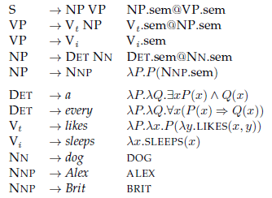
Example

Slide 39
Representing Events
One limitation of FOL is that it only allows events with a fixed arity (number of arguments).
Ideally, there would be a direct mapping from a verb’s subcategorization frame onto a FOL predicate.
Leaf serves vegetarian fare = Serves(Leaf ,VegetarianFare)
However, events are more complicated since events may involve a host of participants, props, times and locations.

Slide 40
Representing Events
Choosing the correct number of arguments for the predicate representing the meaning of eat is tricky.
1. I ate.
2. I ate a turkey sandwich.
3. I ate a turkey sandwich at my desk.
4. I ate at my desk.
5. I ate lunch.
6. I ate a turkey sandwich for lunch.
7. I ate a turkey sandwich for lunch at my desk

Slide 41
Event variables
Issues? Arity – how can we deal with different #s of arguments?
One predicate per frame
Eating1(Speaker)
Eating2(Speaker,TS)
Eating3(Speaker,TS,Desk)
Eating4(Speaker,Desk)
Eating5(Speaker,TS,Lunch)
Eating6(Speaker,TS,Lunch,Desk)

Slide 42
Event variables
Create predicate with maximum possible arguments
Include appropriate args
Maintains connections
∃w, x, yEating(Speaker,w, x, y)
∃w, xEating(Speaker,TS,w, x)
∃wEating(Speaker,TS,w, Desk)
Eating(Speaker,TS, Lunch, Desk)

Slide 43
Event variables
Event variables to allow us to make assertions about an event without using a single predicate with a fixed number of arguments.
1. Event predicates are refactored with an existentially quantified variable as their only argument.
∃e Eating(e)
2. We can introduce additional predicates to represent the other information we have about the event. These predicates take an event variable as their first argument and related FOL terms as their second argument
∃e Eating(e) ∧ Eater(e, Speaker) ∧ Eaten(e, TurkeySandwich)

Slide 44
Neo-Davidsonian Events
1. Events are captured with predicates that take a single event variable as an argument.
2. We don’t need to specify a fixed number of arguments for a FOL predicate. Instead, we can glue on as many as are provided in the input.
3. No more roles are postulated than are mentioned in the input.
4. The connections across related inputs that share the same predicate are satisfied without the need for additional inference.

Slide 45
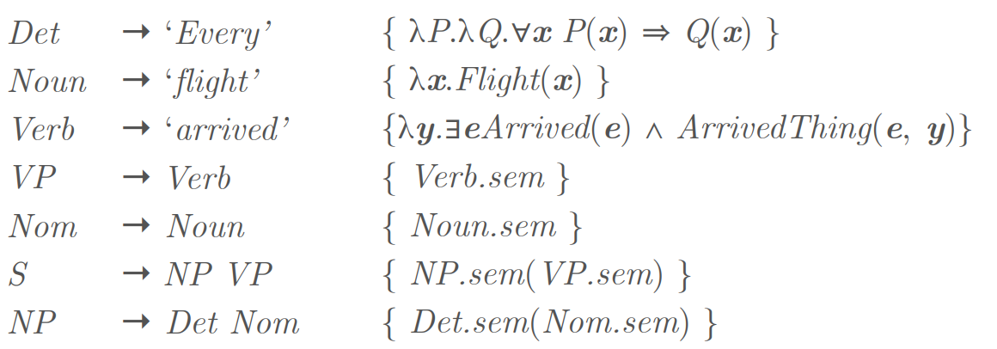
Example
Input: Every flight arrived

Slide 46
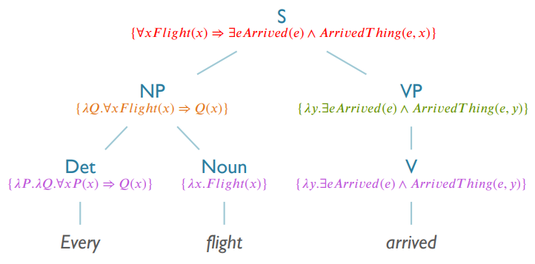
Example (Contd..)

Slide 47
Temporal Logic
I arrived in Hyderabad
I am arriving in Hyderabad.
I will arrive in Hyderabad.
ᴲeArriving(e)^Arriver(e,Speaker)^Destination(e,Hyderabad)

Slide 48
Temporal Logic (Contd..)
Time flows in the forward direction and events can be associated with either points or intervals in time, as on a timeline.
Ordering can be imposed on distinct events by situating them on the timeline.
Add additional predicts about the time of the event variable e.

Slide 49
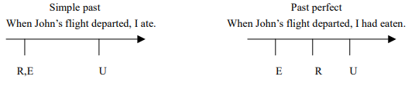
Representing perfect tense
Reichenbach introduced the notion of a reference point. The notion of reference point (R) is separated out from the utterance time (U) and the event time.(E)
The “departure” event is the reference point. The “eating” is the event.

Slide 50
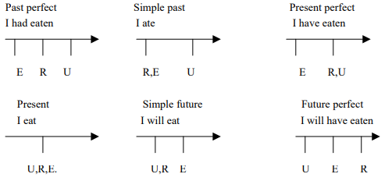
Representing perfect tense (Contd..)

